Slide 1
Tristan Almada
GA Data Science
Final Project Idea 1 – Market Impact of Data Releases on Short-Term Energy Prices
18 October 2016

Slide 2
Many Ways to Skin a Cat…
Fundamentals vs Technicals. Where’s the edge?
Fundamentals: supply/demand analysis
Technicals: price analysis
Is it possible to compete with machines in “High Frequency” domain?
I don’t think so, but maybe after this class…?

Slide 3
Problem Statement
Use database of 1, 5, 30, 90-minute historical futures data to study short-term impact of energy releases on high frequency data. It matters to me!
Energy markets: Crude Oil, Gasoline, Distillate, Natural Gas, Power
Data Sources
Prices: CME, ICE (accessed via Quandl)
Estimates: Reuters, Bloomberg, MMS

Slide 4
Methods, Hypothesis
Technique: estimate short-term market impact of economic releases by regressing moves in the futures curve (either directional, spread or relative value) against “size” of surprise (normalized)
Hypothesis: there is no edge in trading economic surprises in energy markets over a large set of trades.
However, it could still be interesting to quantify “returns” when I have a strong view or what energy markets tend to react most to large surprises.

Slide 5
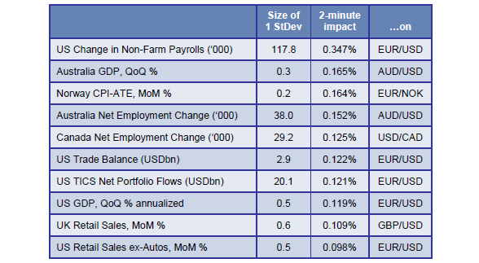
Previous Work in FX Markets
(Citi from 2006)

